Slide 1

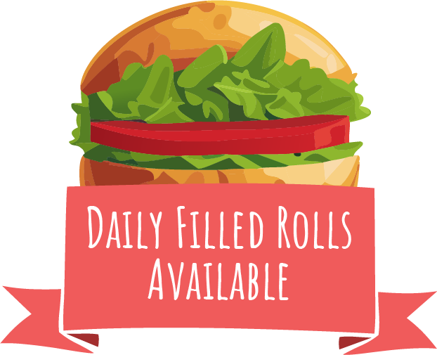




Week 1
Spring Summer 2025
21/04/25, 12/05/25, 02/06/25, 23/06/25, 14/07/25, 04/08/25, 25/08/25, 15/09/25, 06/10/25
Chicken & Vegetable meatballs with pasta
Sweet & Sour Veg with Patsa
Peas
Beans,
Cheese or
Tuna Mayo
Toffee
Biscuit Bars
Picnic Style Chicken
Sausage Roll Lunch
Picnic Style
Veggie Sausage Roll Lunch
Crudites
Beans,
Cheese or
Tuna Mayo
Classic
Trifle
Roast Chicken,
New Potatoes, Stuffing and Gravy
Vegetable and Stuffing Loaf with New Potatoes
Beans,
Cheese or
Tuna Mayo
Bananas
and Custard
Carrots and Cabbage
Tomato and Basil Chicken
Pasta Bake
Margherita Pizza Slice and Wedges
Green Salad
Beans,
Cheese or
Tuna Mayo
Coconut
Crisp Bar
Hot Pasta topped with Homemade
Tomato Sauce & Cheese
Golden Fish Fingers or
Salmon Fingers
and Chips
Cheesy Bean Wrap with Chips
Beans,
Cheese or
Tuna Mayo
Strawberry and
Pineapple Jelly
Beans
W1

Slide 2
Week 2
Spring Summer 2025
28/04/25, 19/05/25, 09/06/25, 30/06/25, 21/07/25, 11/08/25, 01/09/25, 22/09/25, 13/10/25
Beef
Bolognese
Pasta
Veggie
Bolognese
Pasta
Sweetcorn
and Peas
Beans,
Cheese or
Tuna Mayo
Vanilla Cookie
BBQ Chicken Wraps and Paprika Wedges
BBQ Veggie Wrap and Paprika Wedges
Green Beans
Beans,
Cheese or
Tuna Mayo
Jam Sponge and Custard
Roast Chicken,
Skin on Roasties, Stuffing and Gravy
Maple Roasted Sweet Potato Filo Pie with Skin on Roasties
Beans,
Cheese or
Tuna Mayo
Mixed Greens
Oaty Cornflake Crunch Bar
Chicken Sausage, Mash and Gravy
Veggie Sausage
and Mash
Carrots and
Green Beans
Beans,
Cheese or
Tuna Mayo
Apple Sponge Pudding
Hot Pasta topped with Homemade
Tomato Sauce & Cheese
Battered Fish
and Chips
Cheese and Onion Burger
with Chips
Beans,
Cheese or
Tuna Mayo
Watermelon Wedge
Baked
Beans
W1

Slide 3
Week 3
Spring Summer 2025
05/05/25, 26/05/25, 16/06/25, 07/07/25, 28/07/25, 18/08/25, 08/09/25, 29/09/25, 20/10/25
Cheesy Meatball
Bake Topped with Mash
Veggie Shepherdless Pie
Green Salad
Beans,
Cheese or
Tuna Mayo
Strawberry Frozen Yoghurt
Lasagne
Macaroni
Cheese
Green Beans
Beans,
Cheese or
Tuna Mayo
Coconut Cookie
Roast Chicken, Stuffing, Skin on Roasties and Gravy
Cheese and Potato Pie
with Skin on Roasties
Beans,
Cheese or
Tuna Mayo
Brookie
(Brownie & Cookie Mix)
Carrots
and Peas
BBQ Sweetcorn Pizza Slice
with Wedges
Vegetable
Ratatouille
with Rice
Sweetcorn
Beans,
Cheese or
Tuna Mayo
Toffee Apple Crumble
and Custard
Hot Pasta topped with Homemade
Tomato Sauce & Cheese
Golden Fish Fingers
and Chips
Vegetable Fingers
and Chips
Beans,
Cheese or
Tuna Mayo
Peach and Pineapple Jelly
Baked
Beans
W1

